Slide 1

OWASP Zed Attack Proxy (ZAP)
Self-Learning

Slide 2
What is OWASP ZAP?
How does OWASP ZAP Work?
Value of using ZAP
Features of ZAP

Slide 3
What is OWASP ZAP?
A tool designed specifically to find vulnerabilities in web applications
It is known as a “man-in-the-middle proxy”
Completely free and open source

Slide 4

Seven Features that make ZAP a great tool for application security testing
Ajax Spidering
Fuzzing
Flexible Scan Policy Management
Interacting with ZAP Programmatically via the REST API
ZAP Jenkins Plugin
Web Socket testing
Highly Scriptable

Slide 5
It’s Value!
Early-stage identification of vulnerabilities providing fewer last-minute surprises before a release
Provides detailed report of security vulnerabilities for an application
Faster mitigation of vulnerabilities
Reduces time to deliver new features or fixes to production
Reduces the exploitability of existing defects

Slide 6

How does OWASP ZAP work?

Slide 7
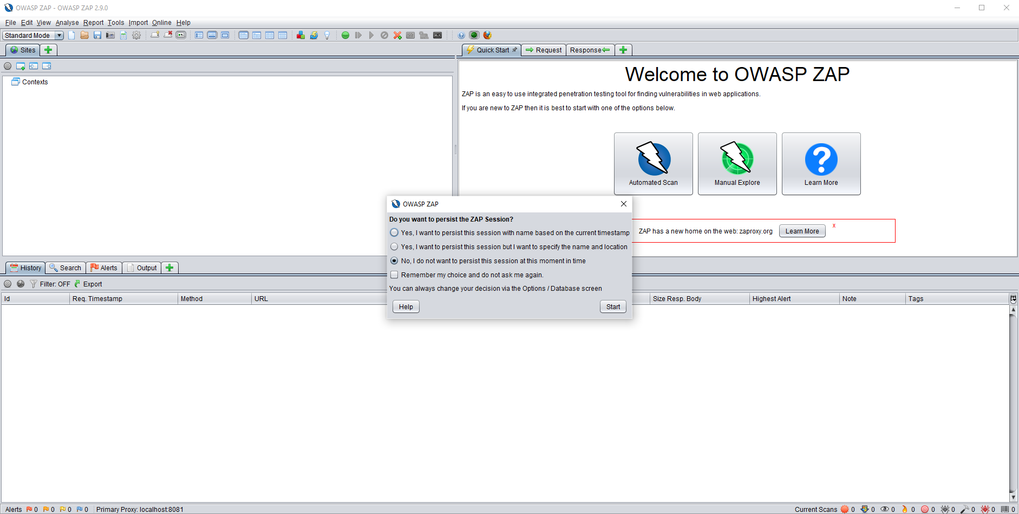
Select No unless you want to save project

Slide 8
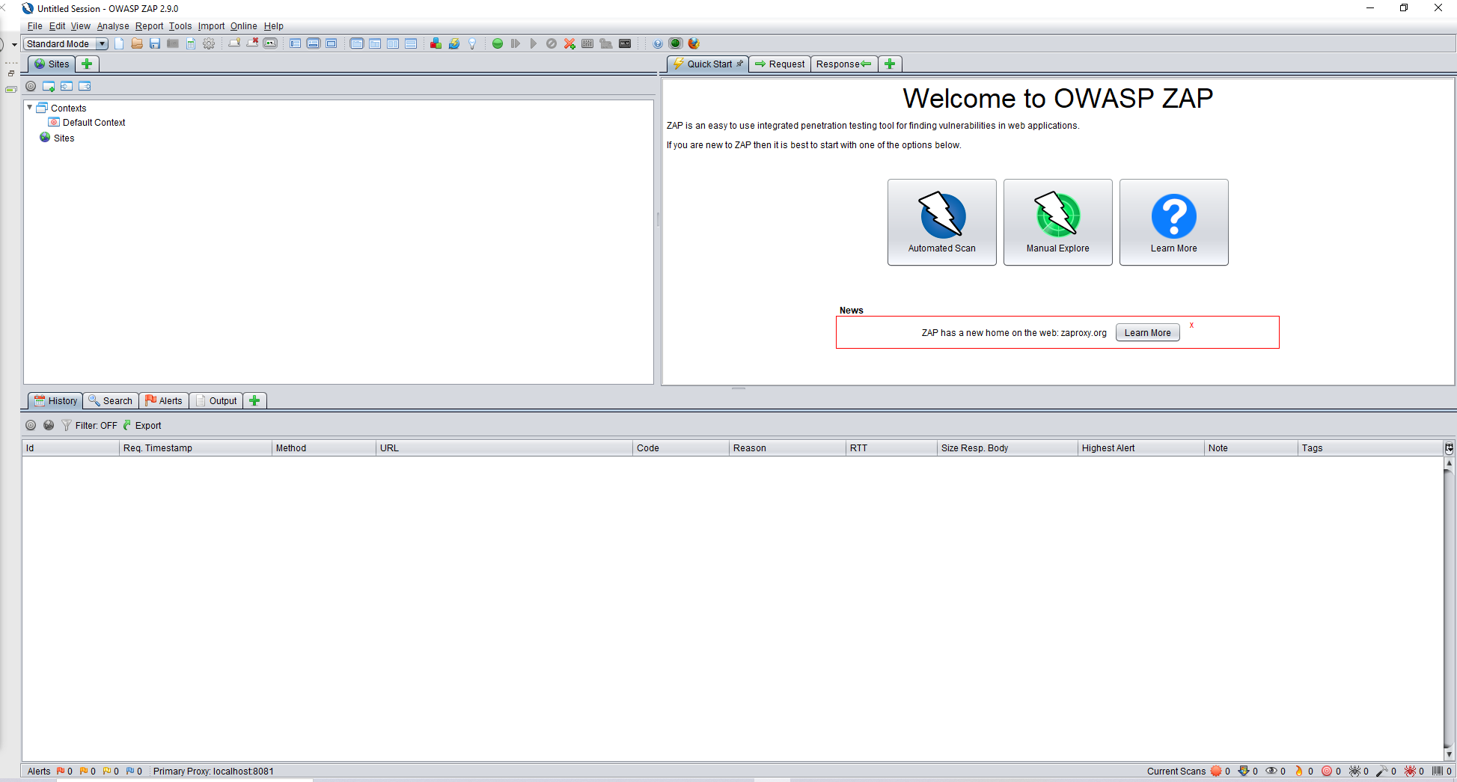
Tree Window
3 Options to choose
Workspace Window
Information Window

Slide 9
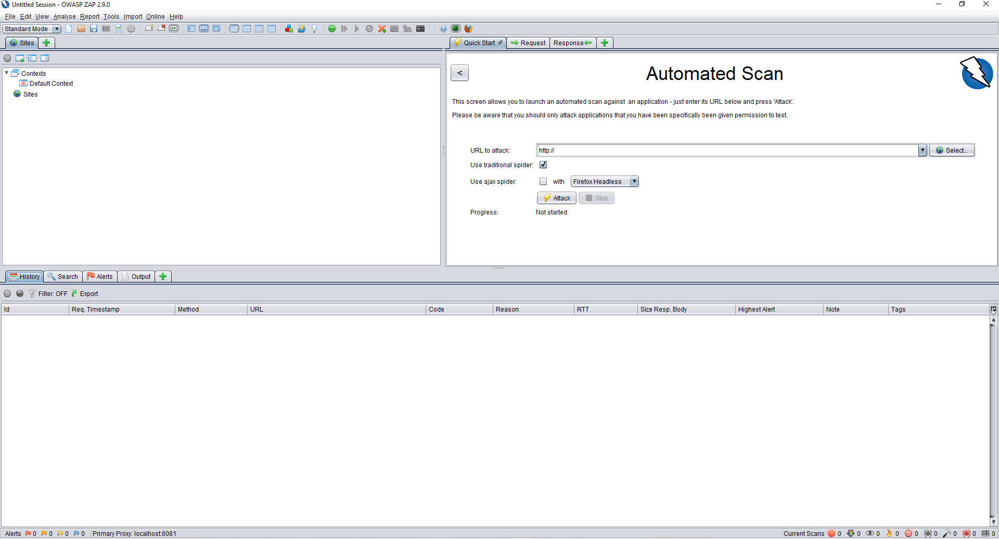

Slide 10
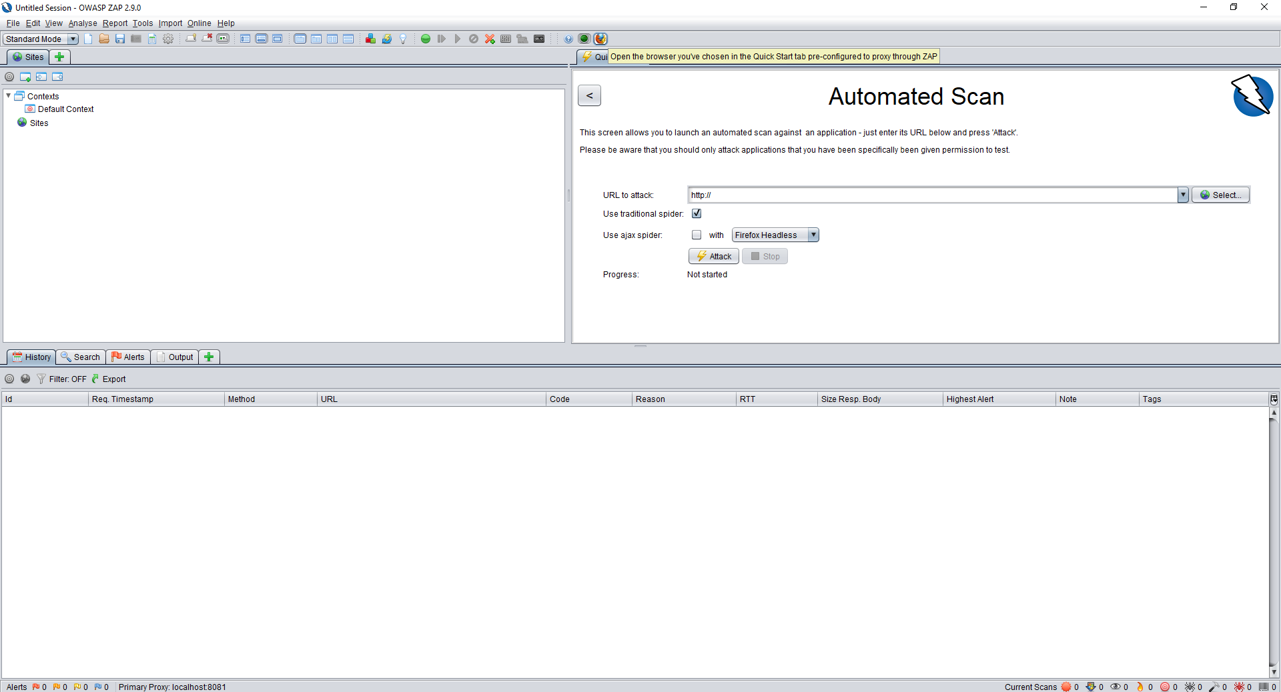
Select to open Proxy

Slide 11
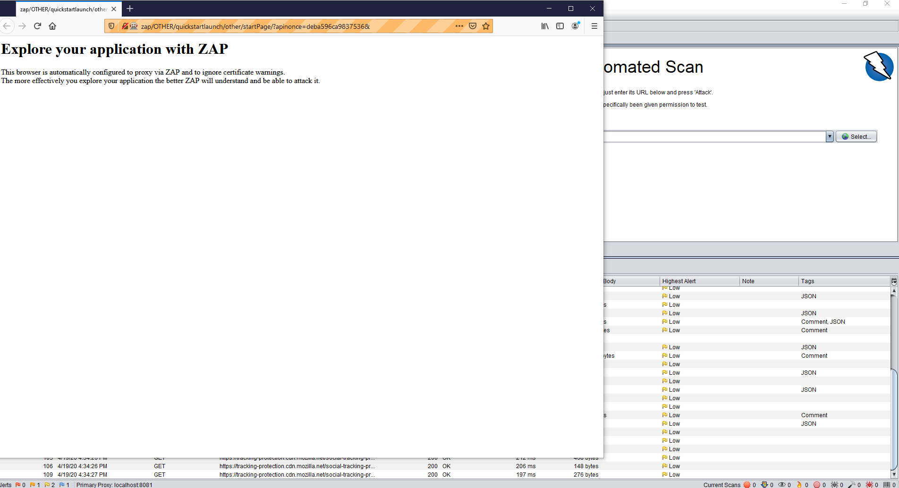
Proxy opens in Mozilla. Add website you want to scan

Slide 12
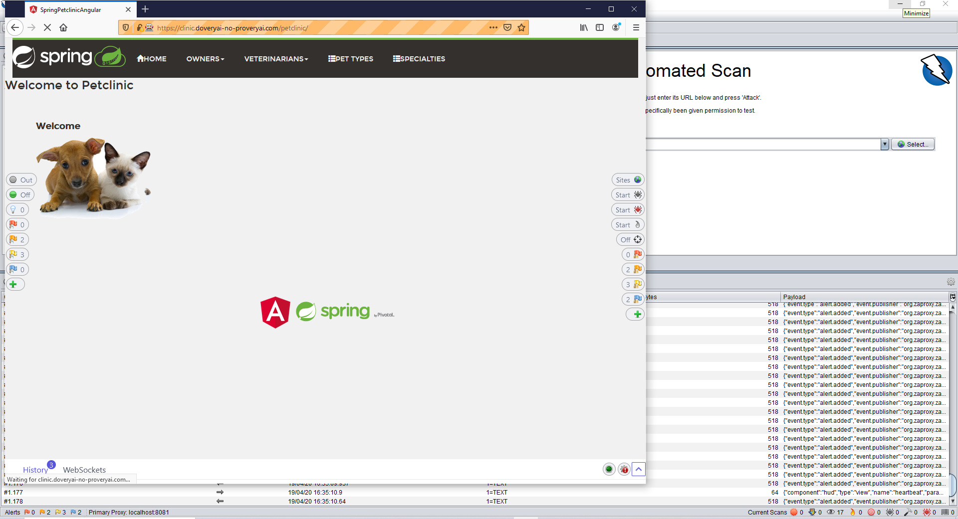

Slide 13
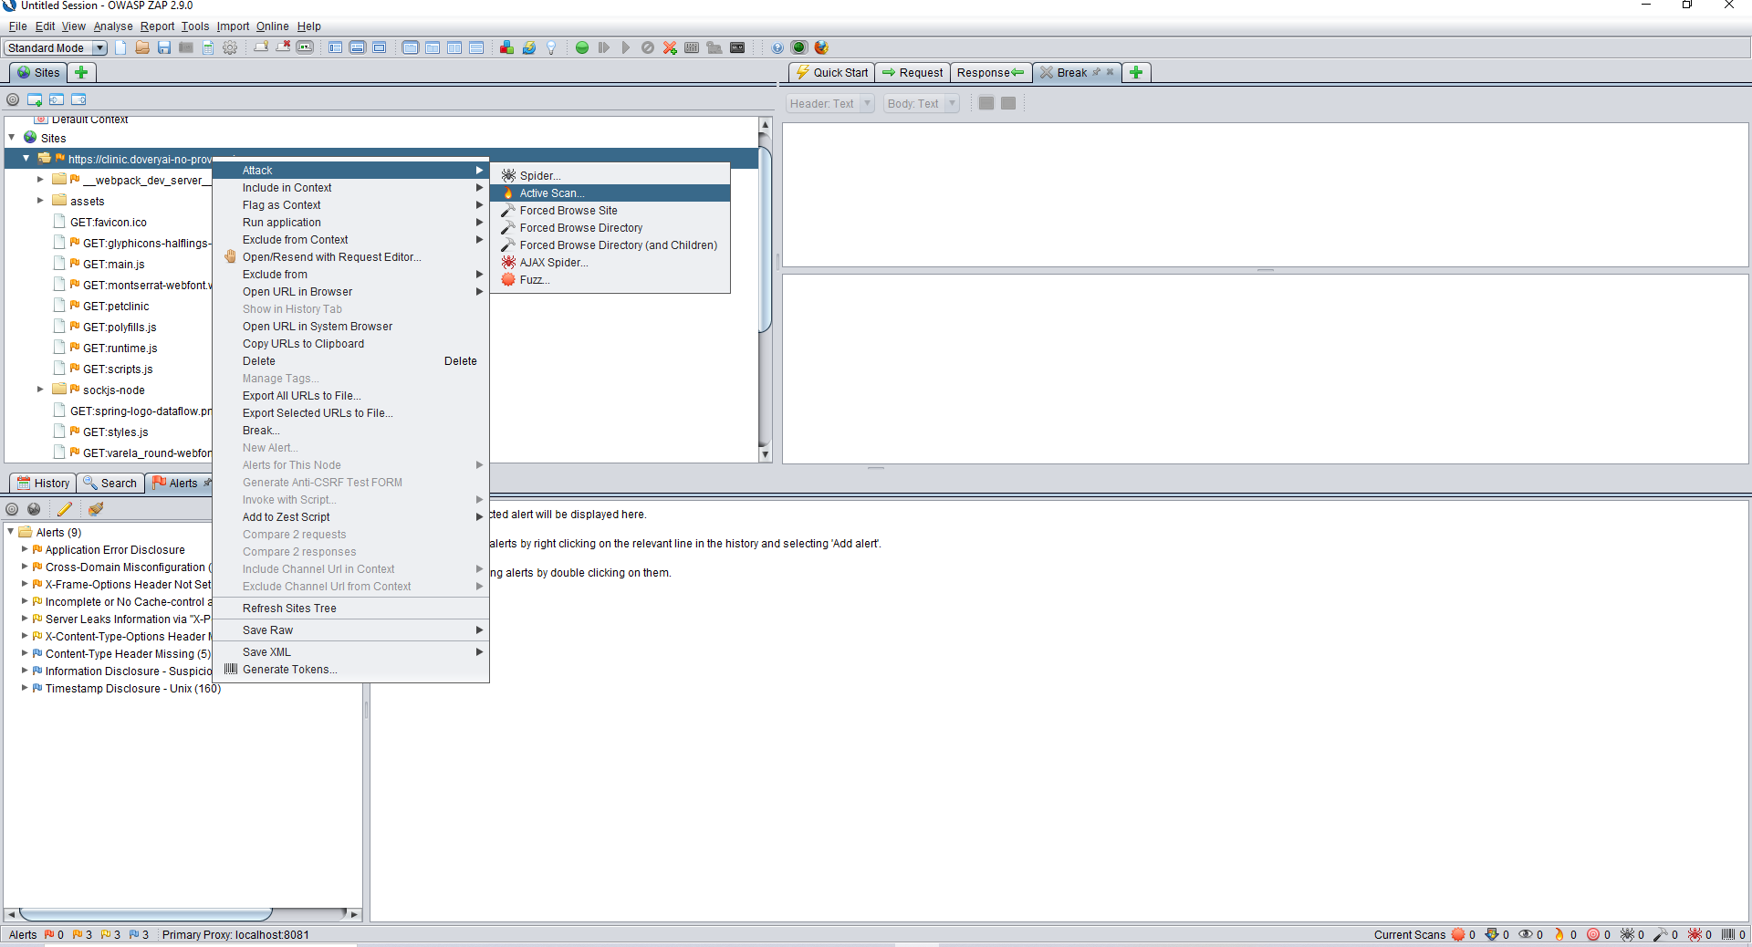
Select Active Scan

Slide 14
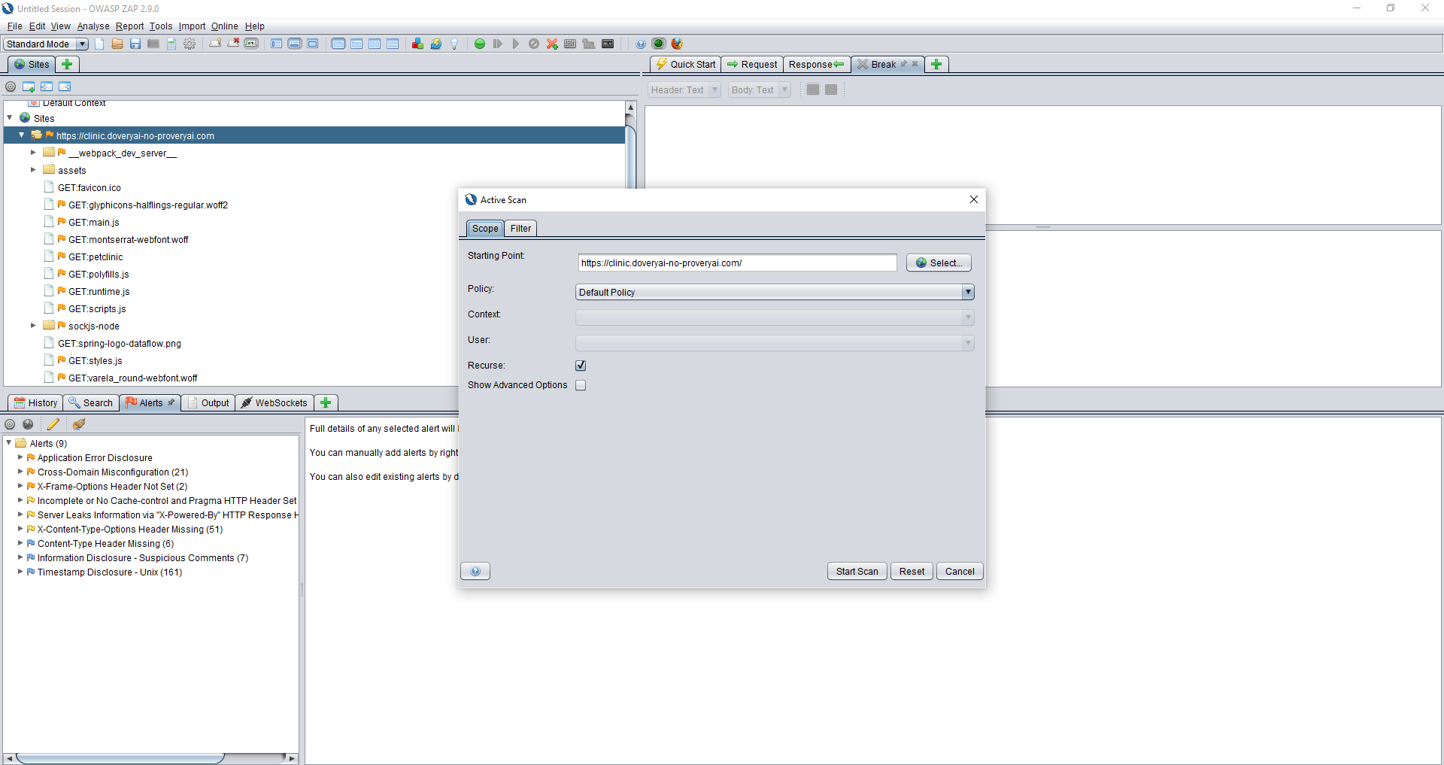

Slide 15
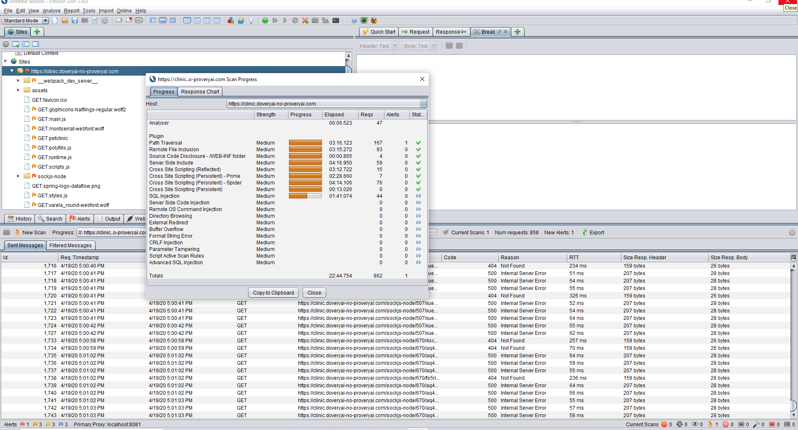
Active Scanning progress

Slide 16
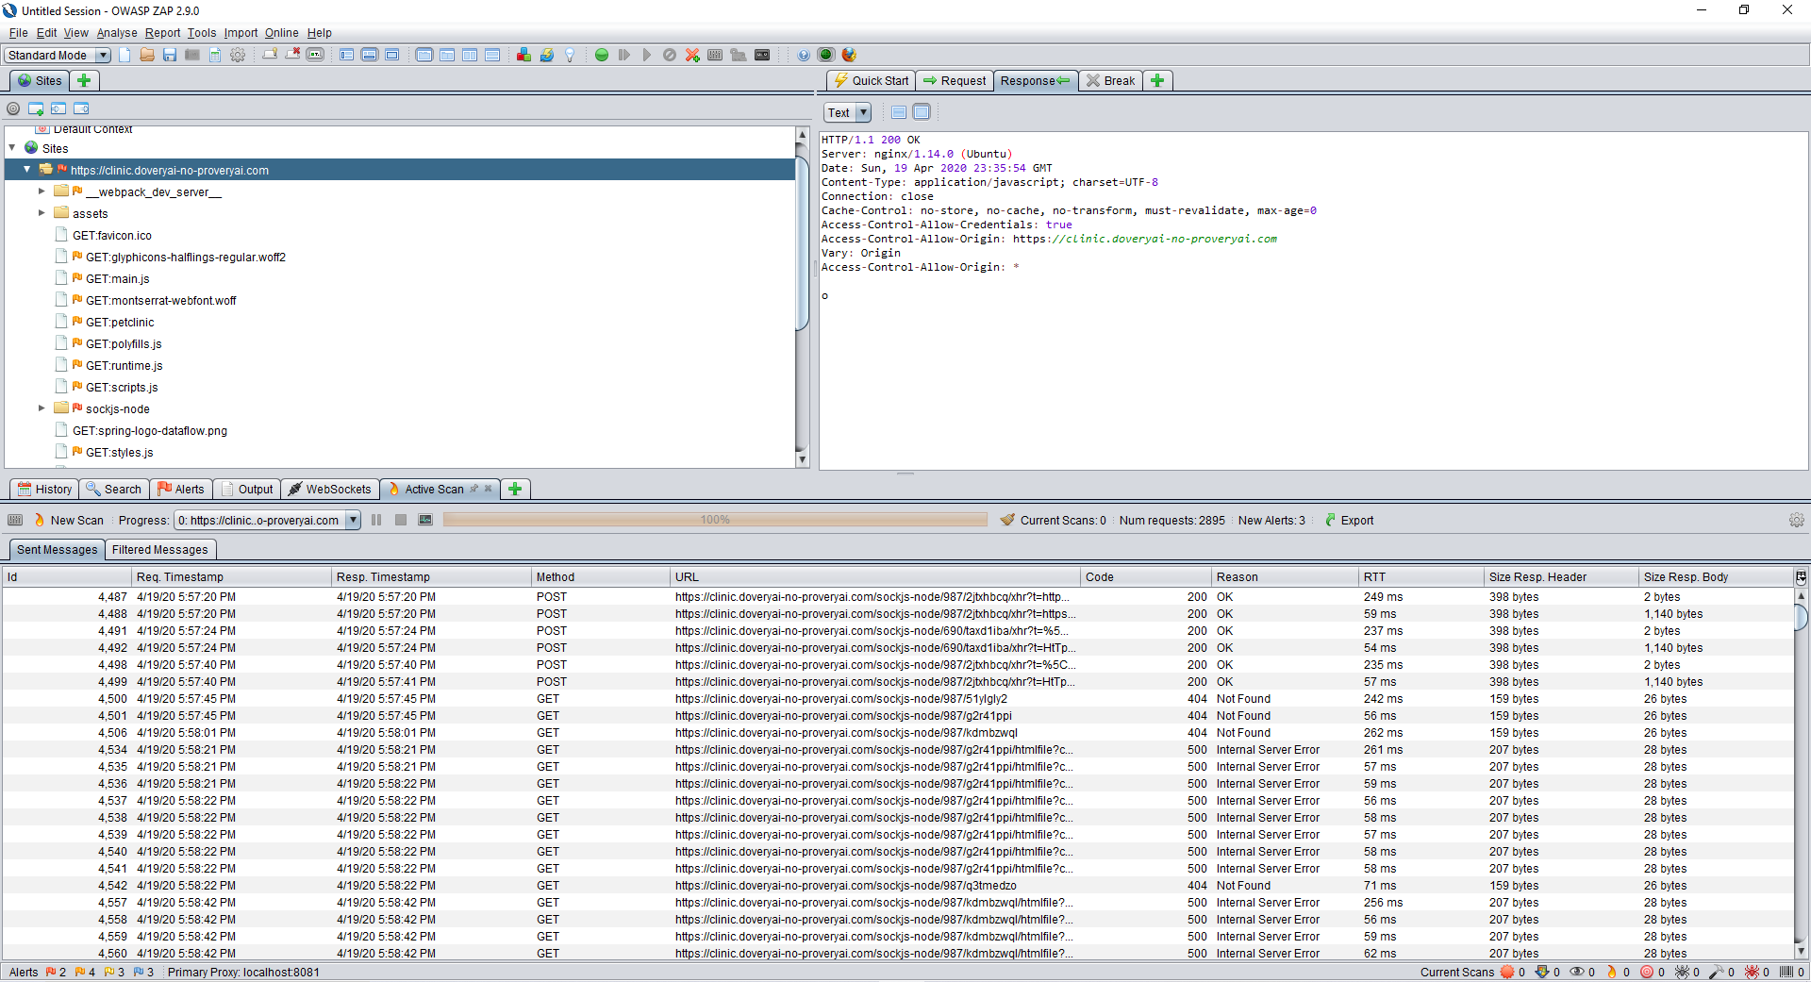

Slide 17
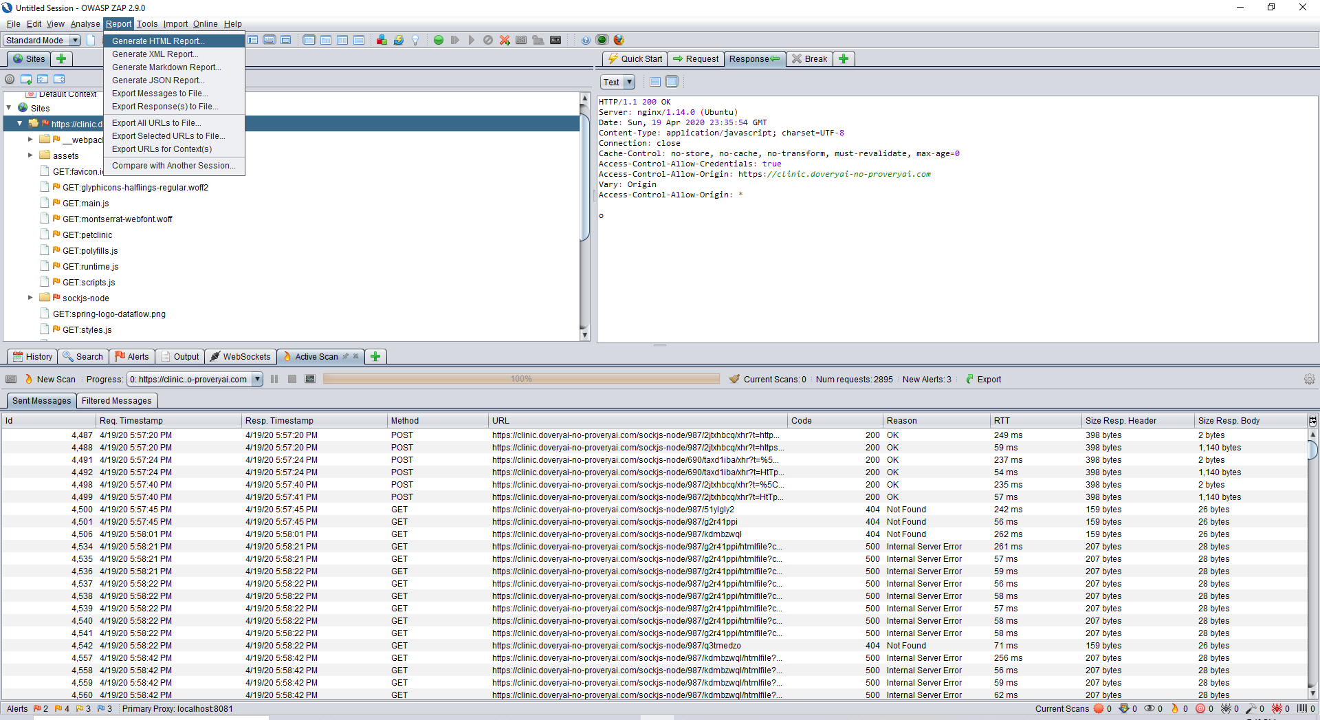
Select Generate as a HTML report

Slide 18
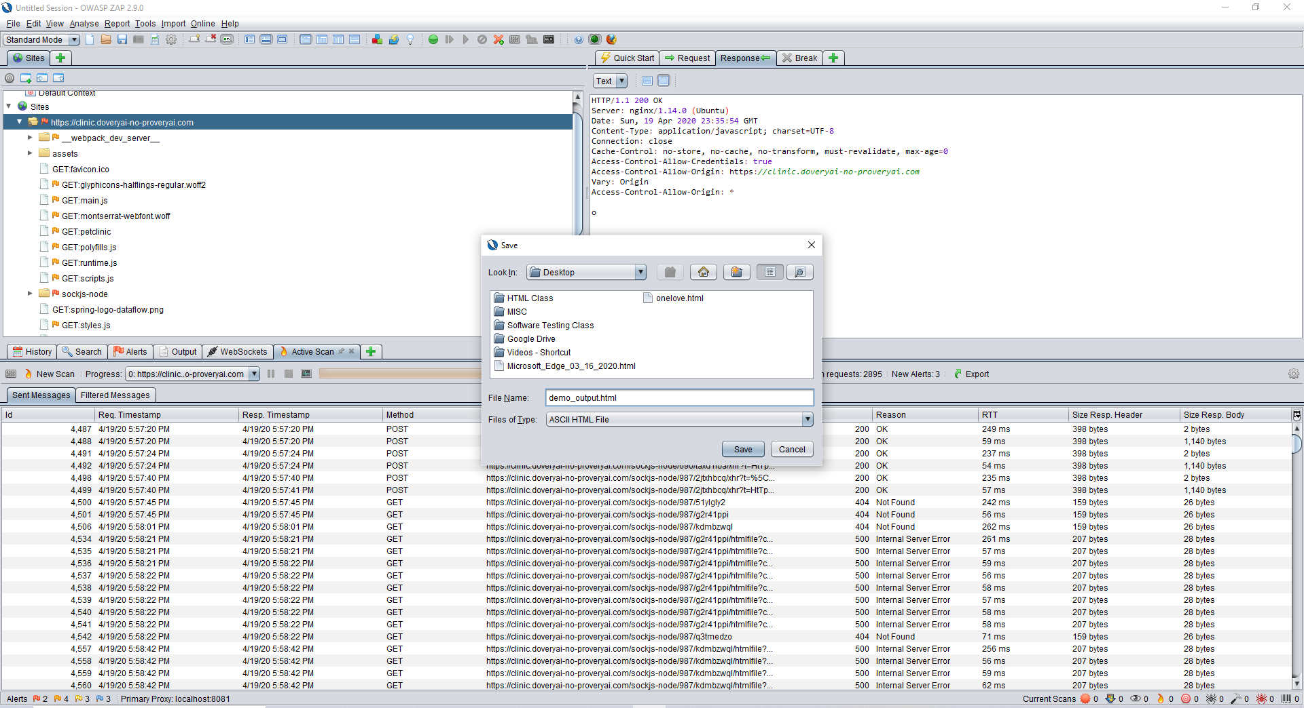
Save file to your location

Slide 19
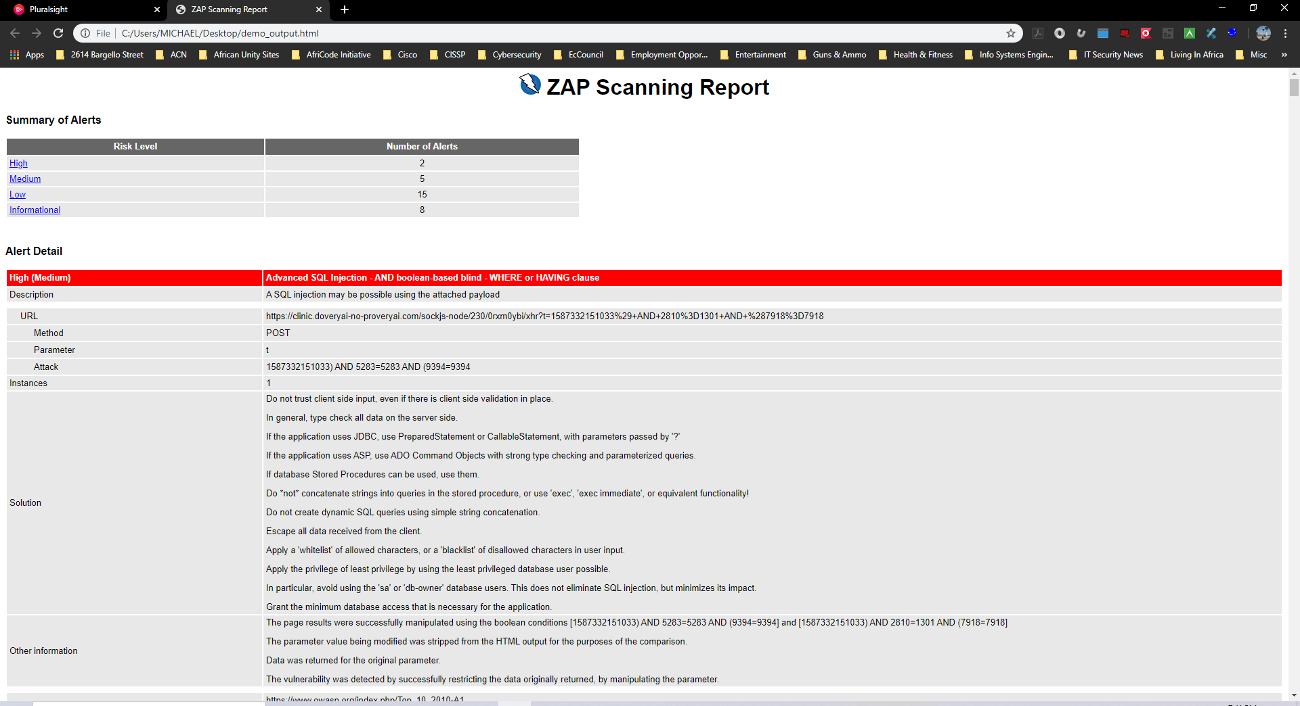
number of alerts categorized by risk level

Slide 20
Questions?

